Slide 1
Regression Modeling Basics

Slide 2
Regression models
Regression models are used to predict one variable from one or more other variables.
Regression models provide the scientist with a powerful tool, allowing predictions about past, present, or future events to be made with information about past or present events.
The scientist employs these models either because it is less expensive in terms of time and/or money to collect the information to make the predictions than to collect the information about the event itself, or, more likely, because the event to be predicted will occur in some future time.
It is also worth noting here that regression models do not make decisions for scientists. Regression models are a source of information about the world. In order to use them wisely, it is important to understand how they work.

Slide 3
Examples
Manufacturing Widgets
A new plant to manufacture widgets is being located in a nearby community. The plant personnel officer advertises the employment opportunity and the next morning has 10,000 people waiting to apply for the 1,000 available jobs. It is important to select the 1,000 people who will make the best employees because training takes time and money and firing is difficult and bad for community relations. In order to provide information to help make the correct decisions, the personnel officer employs a regression model.

Slide 4
Example
Selection and Placement During the World Wars
Technology helped the United States and her allies to win the first and second world wars. One usually thinks of the atomic bomb, radar, bombsights, better designed aircraft, etc when this statement is made. Less well known were the contributions of psychologists and associated scientists to the development of test and prediction models used for selection and placement of men and women in the armed forces.
During these wars, the United States had thousands of men and women enlisting or being drafted into the military. These individuals differed in their ability to perform physical and intellectual tasks. The problem was one of both selection, who is drafted and who is rejected, and placement, of those selected, who will cook and who will fight. The army that takes its best and brightest men and women and places them in the front lines digging trenches is less likely to win the war than the army who places these men and women in the position of leadership.

Slide 5
PROCEDURE FOR CONSTRUCTION OF A REGRESSION MODEL
In order to construct a regression model, both the information which is going to be used to make the prediction and the information which is to be predicted must be obtained from a sample of objects or individuals.
The relationship between the two pieces of information is then modelled with a linear transformation.
Then in the future, only the first information is necessary, and the regression model is used to transform this information into the predicted. In other words, it is necessary to have information on both variables before the model can be constructed.
For example, the personnel officer of the widget manufacturing company might give all applicants a test and predict the number of widgets made per hour on the basis of the test score. In order to create a regression model, the personnel officer would first have to give the test to a sample of applicants and hire all of them. Later, when the number of widgets made per hour had stabilized, the personnel officer could create a prediction model to predict the widget production of future applicants. All future applicants would be given the test and hiring decisions would be based on test performance.

Slide 6
Regression Model Description
X_{i} is the variable used to predict, and is sometimes called the independent variable. In the case of the widget manufacturing example, it would be the test score.
Y_{i} is the observed value of the predicted variable, and is sometimes called the dependent variable. In the example, it would be the number of widgets produced per hour by that individual.
Y'_{i} is the predicted value of the dependent variable. In the example it would be the predicted number of widgets per hour by that individual.
The goal in the regression procedure is to create a model where the predicted and observed values of the variable to be predicted are as similar as possible. For example, in the widget manufacturing situation, it is desired that the predicted number of widgets made per hour be as similar to observed values as possible. The more similar these two values, the better the model

Slide 7
THE LEAST-SQUARES CRITERIA FOR GOODNESS-OF-FIT
In order to develop a measure of how well a model predicts the data, it is valuable to present an analogy of how to evaluate predictions.
Suppose there were two interviewers, Mr. A and Ms. B, who separately interviewed each applicant for the widget manufacturing job for ten minutes. At the end of that time, the interviewer had to make a prediction about how many widgets that applicant would produce two months later.
All of the applicants interviewed were hired, regardless of the predictions, and at the end of the two month's trial period, one interviewer, the best one, was to be retained and promoted, the other was to be fired. The purpose of the following is to develop a measure of goodness-of-fit, or, how well the interviewer predicted.

Slide 8
GOODNESS-OF-FIT
The notational scheme for the table is as follows:
Y_{i} is the observed or actual number of widgets made per hour
Y'_{i} is the predicted number of widgets
Suppose the data for the five applicants were as follows:
 | Interviewer
Observed | Mr. A | Ms. B
Y_{i} | Y'_{i} | Y'_{i}
23 | 38 | 21
18 | 34 | 15
35 | 16 | 32
10 | 10 | 8
27 | 14 | 23

Slide 9
GOODNESS-OF-FIT
The first step is to find how much each interviewer missed the predicted value for each applicant. This is done by finding the difference between the predicted and observed values for each applicant for each interviewer.

Slide 10
GOODNESS-OF-FIT
The first step is to find how much each interviewer missed the predicted value for each applicant. This is done by finding the difference between the predicted and observed values for each applicant for each interviewer.
These differences are called residuals.
 | Interviewer
Observed | Mr. A | Ms . B | Mr. A | Ms. B
Y_{i} | Y'_{i} | Y'_{i} | Y_{i} - Y'_{i} | Y_{i} - Y'_{i}
23 | 38 | 21 | -15 | 2
18 | 34 | 15 | -16 | 3
35 | 16 | 32 | 19 | 3
10 | 10 | 8 | 0 | 2
27 | 14 | 23 | 13 | 4
 |  |  | 1 | 14

Slide 11
GOODNESS-OF-FIT
If the column of differences between the observed and predicted is summed, then it would appear that interviewer A is the better at prediction, because he had a smaller sum of deviations, 1, than interviewer B, with a sum of 14.
This goes against common sense.
In this case large positive deviations cancel out large negative deviations, leaving what appears as an almost perfect prediction for interviewer A, but that is obviously not the case..
To avoid this problem procedure is ignore the signs of the differences and then sum, that is, take the sum of the absolute values. This would work, but for mathematical reasons the sign is eliminated by squaring the differences.

Slide 12

GOODNESS-OF-FIT
 | Interviewer
Obs | Mr. A | Ms . B | Mr. A | Ms. B | Mr. A | Ms. B
Y_{i} | Y'_{i} | Y'_{i} | Y_{i} - Y'_{i} | Y_{i} - Y'_{i} | (Y_{i} - Y'_{i})² | (Y_{i} - Y'_{i})²
23 | 38 | 21 | -15 | 2 | 225 | 4
18 | 34 | 15 | -16 | 3 | 256 | 9
35 | 16 | 32 | 19 | 3 | 361 | 9
10 | 10 | 8 | 0 | 2 | 0 | 4
27 | 14 | 23 | 13 | 4 | 169 | 16
 |  |  | 1 | 14 | 1011 | 42
Summing the squared differences yields the desired measure of goodness-of-fit. In this case the smaller the number, the closer the predicted to the observed values. This is expressed in the following mathematical equation.

Slide 13
THE REGRESSION MODEL
The situation using the regression model is analogous to that of the interviewers, except instead of using interviewers, predictions are made by performing a linear transformation of the predictor variable. Rather than interviewers in the above example, the predicted value would be obtained by a linear transformation of the score. The prediction takes the form
where a and b are parameters in the regression model.

Slide 14
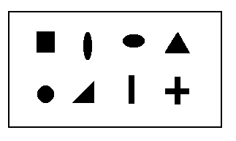
THE REGRESSION MODEL
Suppose that, rather than being interviewed each applicant took a form-board test. A form-board is a board with holes cut out in various shapes: square, round triangular, etc. The goal is to put the right pegs in the right holes as fast as possible. The saying "square peg in a round hole" came from this test, as the test has been around for a long time. The score for the test is the number of seconds it takes to complete putting all the pegs in the right holes.
The data was collected as follows:
Test Score | Widgets/hr
X_{i} | Y_{i}
13 | 23
20 | 18
10 | 35
33 | 10
15 | 27

Slide 15
THE REGRESSION MODEL
Because the two parameters of the regression model, a and b, can take on any real value, there are an infinite number of possible models, analogous to having an infinite number of possible interviewers. The goal of regression is to select the parameters of the model so that the least-squares criterion is met.
For the first model, let a=10 and b=1 attempting to predict the first score perfectly. In this case the regression model becomes
Form-Board | Widgets/hr |  | Residuals | Squared Residuals
Observed | Observed | Predicted
X_{i} | Y_{i} | Y'_{i}=a+bX_{i} | (Y_{i}-Y'_{i}) | (Y_{i}-Y'_{i})²
13 | 23 | 23 | 0 | 0
20 | 18 | 30 | -12 | 144
10 | 35 | 20 | 15 | 225
33 | 10 | 43 | -33 | 1089
15 | 27 | 25 | 2 | 4
 |  |  | (Y_{i}-Y'_{i})² | 1462
Because it is desired that the model work for all applicants, some other values for the parameters must be tried.

Slide 16
THE REGRESSION MODEL
The selections of the parameters for the second model is based on the observation that the longer it takes to put the form board together, the fewer the number of widgets made.
When the tendency is for one variable to increase while the other decreases, the relationship between the variables is said to be inverse. The mathematician knows that in order to model an inverse relationship, a negative value of b must be used in the regression model.
Lets try a=36 and b=-1
Xi | Yi | Y'i=a+bXi | (Yi-Y'i) | (Yi-Y'i)2
13 | 23 | 23 | 0 | 0
20 | 18 | 16 | 2 | 4
10 | 35 | 26 | 9 | 81
33 | 10 | 3 | 7 | 49
15 | 27 | 21 | 6 | 36
 |  |  | (Yi-Y'i)2 | 170

Slide 17
THE REGRESSION MODEL
Fairly large deviations are noted for the third applicant, which might be reduced by increasing the value of the additive component of the transformation, a. Thus a model with a=41 and b=-1 will now be tried.
X_{i} | Y_{i} | Y'_{i}=a+bX_{i} | (Y_{i}-Y'_{i}) | (Y_{i}-Y'_{i})²
13 | 23 | 28 | -5 | 25
20 | 18 | 21 | -3 | 19
10 | 35 | 31 | 4 | 16
33 | 10 | 8 | 2 | 4
15 | 27 | 26 | 1 | 1
 |  |  | (Y_{i}-Y'_{i})² | 55
It is still a better solution than previous
"When do we know when to stop?"

Slide 18
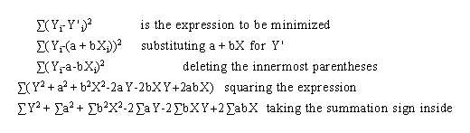

THE REGRESSION MODEL
The mathematical problem can be stated as follows:
"The values of a and b in the linear model Y'_{i} = a + b X_{i} are to be found which minimize the algebraic expression

Slide 19
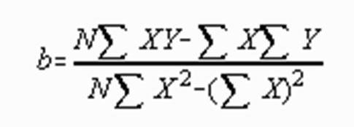
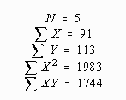
THE REGRESSION MODEL
 | X_{i} | Y_{i} | X_{i}² | X_{i}Y_{i}
 | 13 | 23 | 169 | 299
 | 20 | 18 | 400 | 360
 | 10 | 35 | 100 | 350
 | 33 | 10 | 1089 | 330
 | 15 | 27 | 225 | 405
SUM | 91 | 113 | 1983 | 1744

Slide 20
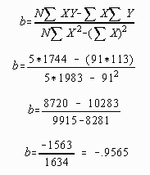
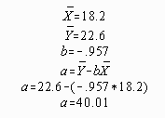
GOODNESS-OF-FIT
This procedure results in an "optimal" model. That is, no other values of a and b will yield a smaller sum of squared deviations.

Slide 21
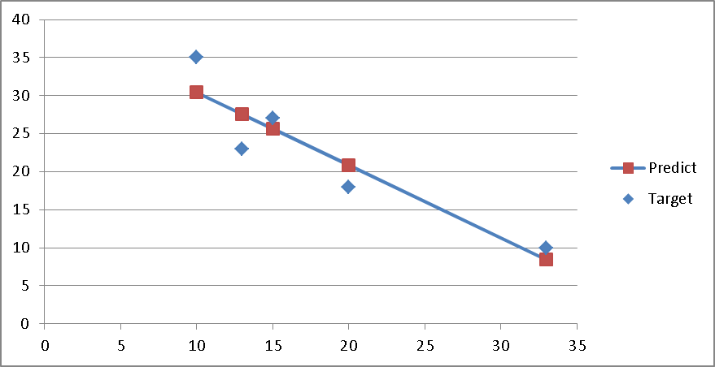
THE REGRESSION MODEL

Slide 22

THE STANDARD ERROR OF ESTIMATE
The standard error of estimate is a measure of error in prediction
The standard error of estimate is a standard deviation type of measure. Note the similarity of the definitional formula of the standard deviation of Y to the definitional formula for the standard error of measurement.
Two differences appear.
First, the standard error of measurement divides the sum of squared deviations by N-2, rather than N-1.
Second, the standard error of measurement finds the sum of squared differences around a predicted value of Y, rather than the mean.

Slide 23
Conditional distribution
A conditional distribution is a distribution of a variable given a particular value of another variable. For example, a conditional distribution of number of widgets made exists for each possible value of number of seconds to put the form board together. Conceptually, suppose that an infinite number of applicants had made the same score of 18 on the form board test. If everyone was hired, not everyone make the same number of widgets three months later. The distribution of scores which results would be called the conditional distribution of Y (widgets) given X (form board). The relationship between X and Y in this case is often symbolized by Y |X. The conditional distribution of Y given that X was 18 would be symbolized as Y |X=18.
It is possible to model the conditional distribution with the normal curve. In order to create a normal curve model, it is necessary to estimate the values of the parameters of the model, mu and sigma.
for x=18, y=mu= 40.01-.957*18= 22.78
The standard error of estimate is often used as an estimate of d _{Y |X} for all the conditional distributions

Slide 24
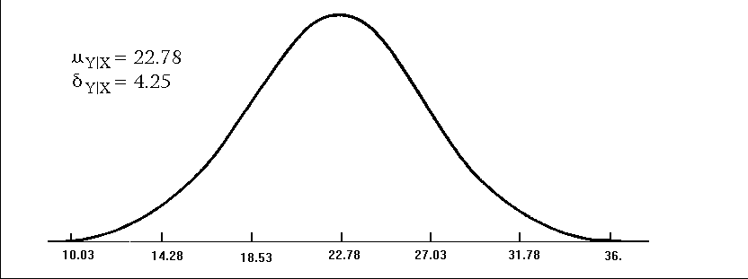
Conditional distribution
The standard error of estimate is often used as an estimate of ‘sigma’ for all the conditional distributions.
This assumes that all conditional distributions have the same value for this parameter.
One interpretation of the standard error of estimate, then, is an estimate of the value of ‘Sigma’ the ‘Std Deviation’ for all possible conditional distributions or values of X.
The conditional distribution which results when X=18 is presented below.

Slide 25
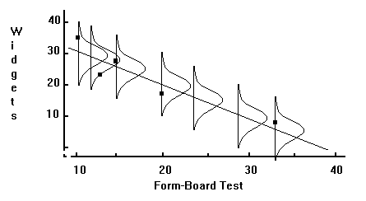
Conditional distribution
It is somewhat difficult to visualize all possible conditional distributions in only two dimensions, although the following illustration attempts the relatively impossible. If a hill can be visualized with the middle being the regression line, the vision would be essentially correct.
The conditional distribution is a model of the distribution of points around the regression line for a given value of X. The conditional distribution is important in this text mainly for the role it plays in computing an interval estimate.

Slide 26
INTERVAL ESTIMATES
The error in prediction may be incorporated into the information given to the client by using interval estimates rather than point estimates. A point estimate is the predicted value of Y, Y'. While the point estimate gives the best possible prediction, as defined by the least squares criterion, the prediction is not perfect. The interval estimate presents two values; low and high, between which some percentage of the observed scores are likely to fall. For example, if a person applying for a position manufacturing widgets made a score of X=18 on the form board test, a point estimate of 22.78 would result from the application of the regression model and an interval estimate might be from 14.25 to 31.11. The interval computed is a 95 per cent confidence interval. It could be said that 95 times out of 100 the number of widgets made per hour by an applicant making a score of 18 on the form board test would be between 14.25 and 31.11.
Other sizes of confidence intervals could be computed by changing the value of z.

Slide 27
INTERVAL ESTIMATES

Slide 35
APPLICATIONS
Systems – facility or process, actual or planned
Examples
Manufacturing facility
Bank operation
Airport operations (passengers, security, planes, crews, baggage)
Transportation/logistics/distribution operation
Hospital facilities (emergency room, operating room, admissions)
Computer network
Freeway system
Business process (insurance office)
Criminal justice system
Chemical plant
Fast-food restaurant
Supermarket
Theme park
Emergency-response system

Slide 36
SYSTEM
A set of interacting components or entities operating together to achieve a common goal or objective.
Examples:
A manufacturing system with its machine centers, inventories, conveyor belts, production schedule, items produced.
A telecommunication system with its messages, communication network servers.
A theme park with rides, workers, …
REAL WORLD SYSTEMS OF INTEREST ARE HIGHLY COMPLEX!!!

Slide 37
WHY & HOW TO STUDY A SYSTEM
Measure/estimate performance
Improve operation
Prepare for failures
System
Experiment
with the
actual system
Experiment with
a physical model
of the system
Experiment with a
mathematical model
of the system
IE 325
IE 202
IE 303
…
Mathematical
Analysis
IE 324
Simulation

Slide 38
MATHEMATICAL MODEL
An abstract and simplified representation of a system
Specifies
Important components
Assumptions/approximations about how the system works
Not an exact re-creation of the original system!
If model is simple enough, study it with Queueing Theory, Linear Programming, Differential Equations...
If model is complex, Simulation is the only way!!!

Slide 39
GETTING ANSWERS FROM MODELS
ACTUAL SYSTEM
Operating Policies
Single queue, parallel servers
FIFO
Input Parameters
No of servers
Inter-arrival Time Distribution
Service Time Distributions
(X)
(Y)
Output Parameters
Waiting Times
System Size
Utilizations
MODEL
Y = f (X)

Slide 40
STOCHASTIC MODELS
Randomness or uncertainty is inherent
Example: Bank with customers and tellers
μ
λ
μ
μ
ACTUAL SYSTEM
QUEUEING MODEL

Slide 41
CLASSIFICATION OF SIMULATION MODELS
Static (Monte Carlo)
Dynamic Systems
Represents the system at a particular point in time
IID observations (Independent and Identically Distributed Random Variable
Represents the system behaviour over time
Continuous Simulation:
(Stochastic) Differential Equations
Discrete Event Simulation:
System quantities (state variables) change with events
Estimation of π
Risk Analysis in Business
Water Level in a Dam
Queueing Systems
Inventory Systems

Slide 42
HOW TO SIMULATE
Manual
Buffon Needle and Cross Experiments (see Kelton et al.)
Spreadsheets
Programming in General Purpose Languages
Java
Simulation Languages
SIMAN
Simulation Packages
Arena
Issue: Modeling Flexibility vs. Ease of Use

Slide 43
ADVANTAGES OF SIMULATION
When mathematical analysis methods are not available, simulation may be the only investigation tool
When mathematical analysis methods are available, but are so complex that simulation may provide a simpler solution
Allows comparisons of alternative designs or alternative operating policies
Allows time compression or expansion

Slide 44
DISADVANTAGES OF SIMULATION
For a stochastic model, simulation estimates the output while an analytical solution, if available, produces the exact output
Often expensive and time consuming to develop
An invalid model may result with confidence in wrong results.

Slide 45
STEPS IN A SIMULATION STUDY
Model
conceptualization
No
Experimental
Design
Setting of
objectives
and overall
project plan
Yes
Problem
formulation
Model
translation
Verified?
Yes
Validated?
Production runs
and analysis
No
Yes
Yes
Data
collection
No
More runs?
No
Implementation
Documentation
and reporting

Slide 46
PROBLEM FORMULATION
A statement of the problem
the problem is clearly understood by the simulation analyst
the formulation is clearly understood by the client

Slide 47
SETTING OF OBJECTIVES & PROJECT PLAN
Project Proposal
Determine the questions that are to be answered
Identify scenarios to be investigated
Decision criteria
Determine the end-user
Determine data requirements
Determine hardware, software, & personnel requirements
Prepare a time plan
Cost plan and billing procedure

Slide 48
STEPS IN A SIMULATION STUDY
Model
conceptualization
No
Experimental
Design
Setting of
objectives
and overall
project plan
Yes
Problem
formulation
Model
translation
Verified?
Yes
Validated?
Production runs
and analysis
No
Yes
Yes
Data
collection
No
More runs?
No
Implementation
Documentation
and reporting

Slide 49
MODEL CONCEPTUALIZATION
Real World System
Assumed system
Conceptual model
Logical model

Slide 50
CONCEPTUAL MODEL
Abstract essential features
Events, activities, entities, attributes, resources, variables, and their relationships
Performance measures
Data requirements
Select correct level of details (assumptions)

Slide 51
LEVELS OF DETAIL
Low levels of detail may result in lost of information and goals cannot be accomplished
High levels of detail require:
more time and effort
longer simulation runs
more likely to contain errors

Slide 52
Accuracy of the model
Scope & level of details
Cost of model
Scope & level of details

Slide 53

COMPONENTS OF A SYSTEM
Entity: is an object of interest in the system
Dynamic objects — get created, move around, change status, affect and are affected by other entities, leave (maybe)
Usually have multiple realizations floating around
Can have different types of entities concurrently
Example: Health Center
Patients
Visitors

Slide 54
COMPONENTS OF A SYSTEM
Attribute: is a characteristic of all entities, but with a specific value “local” to the entity that can differ from one entity to another.
Example: Patient
Type of illness,
Age,
Sex,
Temperature,
Blood Pressure

Slide 55
COMPONENTS OF A SYSTEM
Resources: what entities compete for
Entity seizes a resource, uses it, releases it
Think of a resource being assigned to an entity, rather than an entity “belonging to” a resource
“A” resource can have several units of capacity which can be changed during the simulation
Example: Health Center
Doctors, Nurses
X-Ray Equipment

Slide 56
COMPONENTS OF A SYSTEM
Variable: A piece of information that reflects some characteristic of the whole system, not of specific entities
Entities can access, change some variables
Example: Health Center
Number of patients in the system,
Number of idle doctors,
Current time

Slide 57
COMPONENTS OF A SYSTEM
State: A collection of variables that contains all the information necessary to describe the system at any time
Example: Health Center
{Number of patients in the system,
Status of doctors (busy or idle),
Number of idle doctors,
Status of Lab equipment, etc}

Slide 58

COMPONENTS OF A SYSTEM
Event: An instantaneous occurrence that changes the state of the system
Example: Health Centre
Arrival of a new patient,
Completion of service (i.e., examination)
Failure of medical equipment, etc.

Slide 59
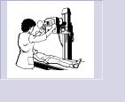
COMPONENTS OF A SYSTEM
Activity: represents a time period of specified length.
Example: Health Center
Surgery,
Checking temperature,
X-Ray.

Slide 60
LOGICAL (FLOWCHART) MODEL
Shows the logical relationships among the elements of the model
2
Departure event
L(t)=L(t)-1
NO
Q(t)> 0 ?
YES
B(t)=0
Q(t)=Q(t)-1
Generate service &
schedule new departure
L : # of entities in system
Q : # of entities in queue
B : # of entities in server
3
Collect & update statistics
TB, TQ, TL, N

Slide 61
STEPS IN A SIMULATION STUDY
Model
conceptualization
No
Experimental
Design
Setting of
objectives
and overall
project plan
Yes
Problem
formulation
Model
translation
Verified?
Yes
Validated?
Production runs
and analysis
No
Yes
Yes
Data
collection
No
More runs?
No
Implementation
Documentation
and reporting

Slide 62
DATA COLLECTION & ANALYSIS
Collect data for input analysis and validation
Analysis of the data
Determine the random variables
Fit distribution functions

Slide 63
STEPS IN A SIMULATION STUDY
Model
conceptualization
No
Experimental
Design
Setting of
objectives
and overall
project plan
Yes
Problem
formulation
Model
translation
Verified?
Yes
Validated?
Production runs
and analysis
No
Yes
Yes
Data
collection
No
More runs?
No
Implementation
Documentation
and reporting

Slide 64
MODEL TRANSLATION
Simulation model executes the logic contained in the flow-chart model
Coding
General Purpose Language
Special Purpose Simulation Language/Software
Examples:
Examples:
JAVA, C++, Visual BASIC
SIMAN, ARENA, EXTEND

Slide 65
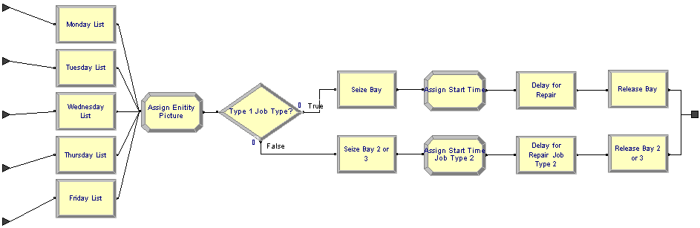
ARENA EXAMPLE

Slide 66
JAVA EXAMPLE
public static void main(String argv[])
{
Initialization();
//Loop until first "TotalCustomers" have departed
while (NumberofDepartures < TotalCustomers)
{
Event evt = FutureEventList[0]; //get imminent event
removefromFEL(); //be rid of it
Clock = evt.get_time(); //advance in time
if (evt.get_type() == arrival) ProcessArrival();
else ProcessDeparture();
}
ReportGeneration();
}

Slide 67
STEPS IN A SIMULATION STUDY
Model
conceptualization
No
Experimental
Design
Setting of
objectives
and overall
project plan
Yes
Problem
formulation
Model
translation
Verified?
Yes
Validated?
Production runs
and analysis
No
Yes
Yes
Data
collection
No
More runs?
No
Implementation
Documentation
and reporting

Slide 68
VERIFICATION AND VALIDATION
Verification: the process of determining if the operational logic is correct.
Debugging the simulation software
Validation: the process of determining if the model accurately represents the system.
Comparison of model results with collected data from the real system

Slide 69
VERIFICATION AND VALIDATION
Real World System
VALIDATION
Conceptual model
Logical model
VERIFICATION
Simulation model

Slide 70
STEPS IN A SIMULATION STUDY
Model
conceptualization
No
Experimental
Design
Setting of
objectives
and overall
project plan
Yes
Problem
formulation
Model
translation
Verified?
Yes
Validated?
Production runs
and analysis
No
Yes
Yes
Data
collection
No
More runs?
No
Implementation
Documentation
and reporting

Slide 71
EXPERIMENTAL DESIGN
Alternative scenarios to be simulated
Type of output data analysis (steady-state vs. terminating simulation analysis)
Number of simulation runs
Length of each run
The manner of initialization
Variance reduction

Slide 72
ANALYSIS OF RESULTS
Statistical tests for significance and ranking
Point Estimation
Confidence-Interval Estimation
Interpretation of results
More runs?

Slide 73
STEPS IN A SIMULATION STUDY
Model
conceptualization
No
Experimental
Design
Setting of
objectives
and overall
project plan
Yes
Problem
formulation
Model
translation
Verified?
Yes
Validated?
Production runs
and analysis
No
Yes
Yes
Data
collection
No
More runs?
No
Implementation
Documentation
and reporting

Slide 74
DOCUMENTATION & REPORTING
Program Documentation
Allows future modifications
Creates confidence
Progress Reports
Frequent reports (e.g. monthly) are suggested
Alternative scenarios
Performance measures or criteria used
Results of experiments
Recommendations

Slide 75
IMPLEMENTATION
?
FAILURE
SUCCESS

Slide 76
Model
A model is a simplified representation or abstraction of reality.
Reality is generally too complex to copy exactly.
Much of the complexity is actually irrelevant in problem solving.

Slide 77
Types of Models
Model
Physical
Mathematical
Computer
Static
Dynamic
Static
Dynamic
Static
Dynamic
Notes:
77

Slide 78
What is Mathematical Model?
A set of mathematical equations (e.g., differential eqs.) that describes the input-output behavior of a system.
What is a model used for?
Simulation
Prediction/Forecasting
Prognostics/Diagnostics
Design/Performance Evaluation
Control System Design

Slide 79
Classification of Mathematical Models
Linear vs. Non-linear
Deterministic vs. Probabilistic (Stochastic)
Static vs. Dynamic
Discrete vs. Continuous
White box, black box and gray box

Slide 80
Black Box Model
When only input and output are known.
Internal dynamics are either too complex or unknown.
Easy to Model
Input
Output

Slide 81
Grey Box Model
When input and output and some information about the internal dynamics of the system is known.
Easier than white box Modelling.
u(t)
y(t)
y[u(t), t]

Slide 82
White Box Model
When input and output and internal dynamics of the system is known.
One should know have complete knowledge of the system to derive a white box model.
u(t)
y(t)

Slide 83
Mathematical Modelling Basics
Mathematical model of a real world system is derived using a combination of physical laws and/or experimental means
Physical laws are used to determine the model structure (linear or nonlinear) and order.
The parameters of the model are often estimated and/or validated experimentally.
Mathematical model of a dynamic system can often be expressed as a system of differential (difference in the case of discrete-time systems) equations

Slide 84
Why Modeling?
Fundamental and quantitative way to understand and analyse complex systems and phenomena
Complement to Theory and Experiments, and often Integrate them
Becoming widespread in: Computational Physics, Chemistry, Mechanics, Materials, …, Biology

Slide 85
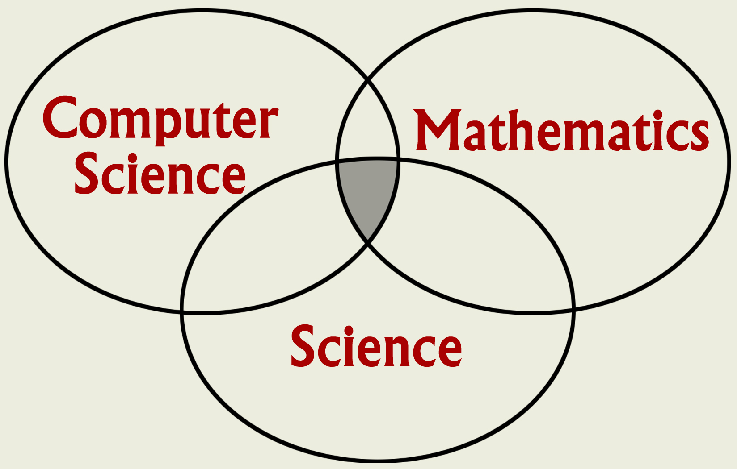
Mathematical Modeling?
Mathematical modeling seeks to gain an understanding of science through the use of mathematical models on HP computers.
Mathematical modeling involves teamwork

Slide 86
Mathematical Modeling
Complements, but does not replace, theory and experimentation in scientific research.
Experiment
Theory
Computation

Slide 87
Mathematical Modeling
Is often used in place of experiments when experiments are too large, too expensive, too dangerous, or too time consuming.
Can be useful in “what if” studies; e.g. to investigate the use of pathogens (viruses, bacteria) to control an insect population.
Is a modern tool for scientific investigation.

Slide 88
Mathematical Modeling
Has emerged as a powerful, indispensable tool for studying a variety of problems in scientific research, product and process development, and manufacturing.
Seismology
Climate modeling
Economics
Environment
Material research
Drug design
Manufacturing
Medicine
Biology
Analyze - Predict
Notes:
Seismology: oil exploration, earthquake prediction (Parallel computation reduced compute time from weeks to hours)
Global ocean/ climate modeling: global warming, weather prediction
Economics: growth of a local or national economy (Agent-based modeling), management of resources, analysis of tax strategies
Environmental: utilization of resources, population modeling, insect control
Materials research: design of new materials, smart materials; shape driven by temperature materials; materials aging issues (Stockpile stewardship)
Drug design: design of anti-cancer drugs, etc.
Manufacturing: optimization of manufacturing processes, automation
Medicine: Medical imaging, MRIs
Human genome: applications to understanding and treating disease

Slide 89
Example: Industry →
First jetliner to be digitally designed, "pre-assembled" on computer, eliminating need for costly, full-scale mockup.
Computational modeling improved the quality of work and reduced changes, errors, and rework.

Slide 90
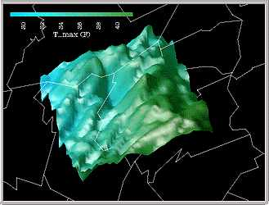
Example: Climate Modeling
3-D shaded relief representation of a portion of PA using color to show max daily temperatures.
Displaying multiple data sets at once helps users quickly explore and analyze their data.
Notes:
Other examples at this site:
Model of a red giant star
Protein folding problem
Impact of an astroid

Slide 91
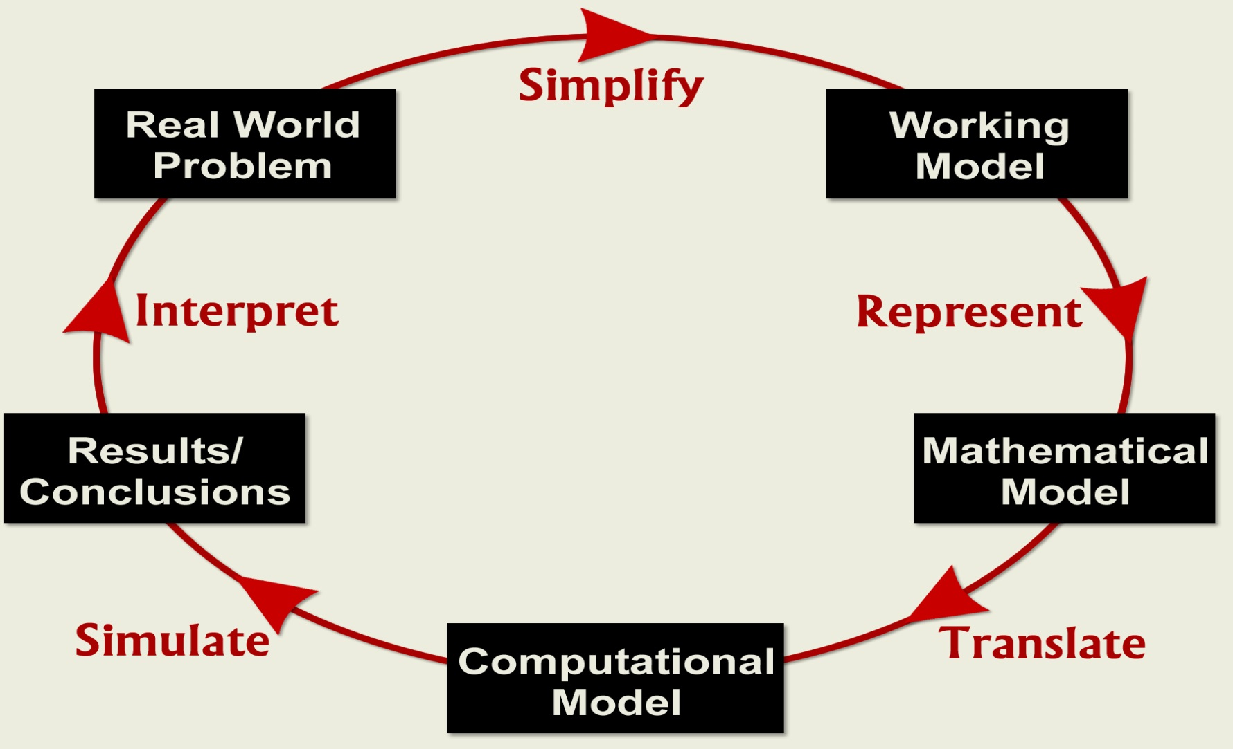
Mathematical Modeling Process

Slide 92
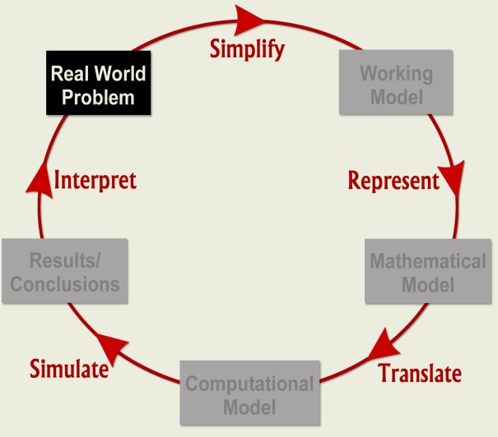
Real World Problem
Identify Real-World Problem:
Perform background research, focus on a workable problem.
Conduct investigations (Labs), if appropriate.
Learn the use of a computational tool: Matlab, Mathematica, Excel, Java.
Understand current activity and predict future behavior.

Slide 93
Example: Falling Rock
Determine the motion of a rock dropped from height, H, above the ground with initial velocity, V.
A discrete model: Find the position and velocity of the rock above the ground at the equally spaced times, t0, t1, t2, …; e.g. t0 = 0 sec., t1 = 1 sec., t2 = 2 sec., etc.
|______|______|____________|______
t0 t1 t2 … tn
Notes:
Models of time-dependent processes may be split into two categories, discrete and continuous, depending on how the time variable is treated.
Key point: x and v remain constant between time points. How accurate is this?
When implemented on a computer, many continuous models become discrete; also rounding error issues.

Slide 94
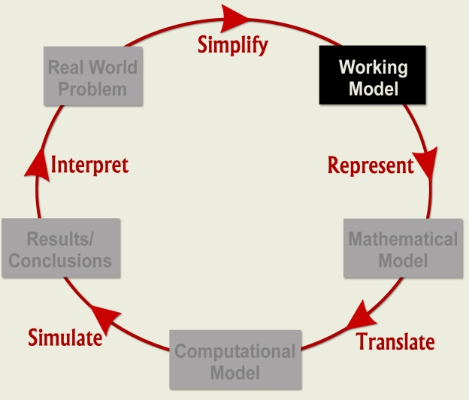
Working Model
Simplify → Working Model: Identify and select factors to describe important aspects of Real World Problem; determine those factors that can be neglected.
State simplifying assumptions.
Determine governing principles, physical laws.
Identify model variables and inter-relationships.
Notes:
Simplify: Purpose is to eliminate unnecessary information and to simplify that which is retained as much as possible.
Simplifying assumptions: no friction in the system (physics), no immigration or emigration (population), constant growth rate (biology), etc.
Governing principles: laws/relationships from physics, biology, engineering economics, etc.; balance equations.
Key variables and relationships
Variables types include input variables, output variables, and parameters.

Slide 95
Example: Falling Rock
Governing principles: d = v*t and v = a*t.
Simplifying assumptions:
Gravity is the only force acting on the body.
Flat earth.
No drag (air resistance).
Model variables are H,V, g; t, x, and v
Rock’s position and velocity above the ground will be modeled at discrete times (t0, t1, t2, …) until rock hits the ground.
Notes:
Constant acceleration model.

Slide 96
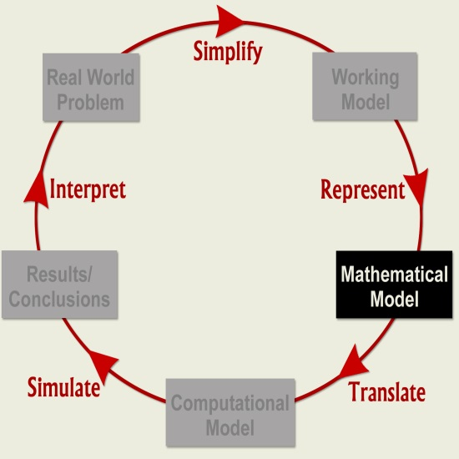
Mathematical Model
Represent → Mathematical Model:
Express the Working Model in mathematical terms; write down mathematical equations whose solution describes the Working Model.
In general, the success of a mathematical model depends on how easy it is to use and how accurately it predicts.
Notes:
A mathematical model is an important step in formalizing a problem for solution on a computer.

Slide 97
Example: Falling Rock
v0 v1 v2 … vn
x0 x1 x2 … xn
|______|______|____________|_____
t0 t1 t2 … tn
t0 = 0; x0 = H; v0 = V
t1= t0 + Δt
x1= x0 + (v0*Δt)
v1= v0 - (g*Δt)
t2= t1 + Δt
x2= x1 + (v1*Δt)
v2= v1 - (g*Δt)
…
Notes:
Input variables are t0=0, x0=H, and v0=V; output variables are the ti, xi and vi; g is a parameter.

Slide 98
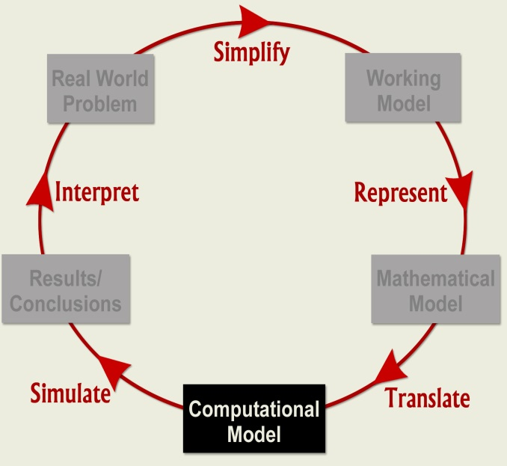
Computational Model
Translate → Computational Model
Change Mathematical Model into a form suitable for computational solution.
Existence of unique solution
Choice of the numerical method
Choice of the algorithm
Software

Slide 99
Computational Model
Translate → Computational Model:
Change Mathematical Model into a form suitable for computational solution.
Computational models include software such as Matlab, Excel, or Mathematica, or languages such as Fortran, C, C++, or Java.

Slide 100
Example: Falling Rock
Pseudo Code
Input
V, initial velocity; H, initial height
g, acceleration due to gravity
Δt, time step; imax, maximum number of steps
Output
ti, t-value at time step i
xi, height at time ti
vi, velocity at time ti

Slide 101
Example: Falling Rock
Initialize
Set ti = t0 = 0; vi = v0 = V; xi = x0 = H
print ti, xi, vi
Time stepping: i = 1, imax
Set ti = ti + Δt
Set xi = xi + vi*Δt
Set vi = vi - g*Δt
print ti, xi, vi
if (xi <= 0), Set xi = 0; quit

Slide 102
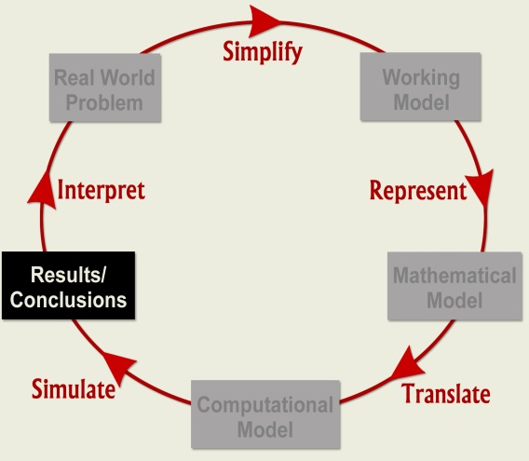
Results/Conclusions
Simulate → Results/Conclusions: Run “Computational Model” to obtain Results; draw Conclusions.
Verify your computer program; use check cases; explore ranges of validity.
Graphs, charts, and other visualization tools are useful in summarizing results and drawing conclusions.
Notes:
Evaluate results; Draw conclusions; Make recommendations.
Falling Rock: Explore approximations.
What is the difference between xcontinuous (exact solution to simplified problem) and xdiscrete (approximate solution to simplified problem)?
Neither xcontinuous nor xdiscrete are necessarily solutions to the real-world problem.

Slide 103
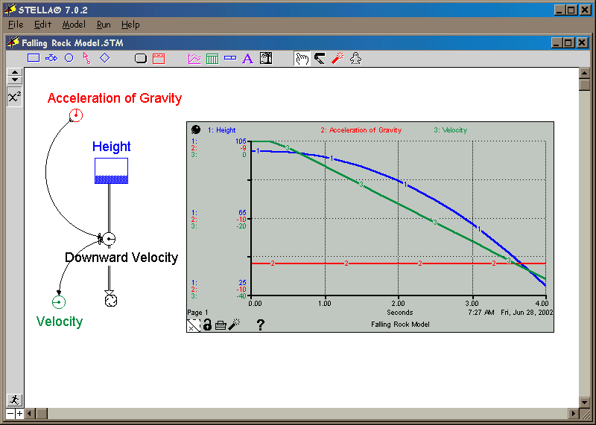
Falling Rock: Model
Notes:
Erin Furtak

Slide 104

Real World Problem
Interpret Conclusions: Compare with Real World Problem behavior.
If model results do not “agree” with physical reality or experimental data, reexamine the Working Model (relax assumptions) and repeat modeling steps.
Often, the modeling process proceeds through several iterations until model is“acceptable”.
Notes:
If model solution is acceptable, communicate results: technical paper, oral presentation, etc. If not, repeat the modeling steps.

Slide 105
Example: Falling Rock
To create a more realistic model of a falling rock, some of the simplifying assumptions could be dropped; e.g., incor-porate drag - depends on shape of the rock, is proportional to velocity.
Improve discrete model:
Approximate velocities in the midpoint of time intervals instead of the beginning.
Reduce the size of Δt.
Notes:
Drag: proportional to v for low velocities, proportional to v^2 for large velocities.

Slide 106

THANK YOU!

